Slide 1
HPS Online Software Discussion
Status and Plans
Jeremy McCormick, SLAC

Slide 2
Overview
Conditions DB
Subdetectors
Beam
Monitoring
Integrated app
Sub-detector tools
Data catalog
Will not discuss DAQ and triggering. Should be well-covered by other talks.

Slide 3
Existing Conditions System
org.lcsim
File system based
Conditions attached to a specific detector version
e.g. “HPS-TestRun-v3”
Simple to access and easy to add new data
Just add a new text file to a directory
All detector data contained in hps-detectors
XML detector descriptions
Conditions associated with that detector model
Test run conditions actually moved to resources in hps-java, easily accessible via Java code using built-in methods
getClass().getResourceAsStream(“/name/of/resource.txt”);

Slide 4
Deficiencies in Current Conditions System
No access of conditions by time validity range
No tagging of conditions by version separate from detector geometry
Not an online system
Not a proper DB
What we have is not really a conditions system!

Slide 5
Conditions System Requirements
Should probably use existing conditions API
Assign time validity to sets of data
Tag data with version
Viewable on the web
APIs for inserting, updating, retrieving
Proper database backend
Single instance (or mirrored copies) that are publically accessible
Possibly accessible (read only) from languages other than Java
e.g. from ROOT analysis macros

Slide 6
Conditions DB Proposal
Use database structure suggested by SLAC EXO group
Validity Table
Tag | Start | End
svt_calibrations:id:1 | Jan 01 2014 XXXX | Jan 02 2014 XXXX
Data Table => svt_calibrations
Id | Pedestal
1 | 1.2345
… | …

Slide 7
Conditions DB Proposal (contd)
Mock-up coded by SLAC computing staff
Conforms to current conditions API in org.lcsim
But not really tested or used
Existing web interface allows browsing conditions tables
Validity by run number, but can be changed to use time range
Q: Does this proposed structure cover our needs or do we want to roll our own? Or use/extend some other existing system?
Q: Should we use time validity rather than run number?
Non-HPS SLAC personnel can contribute to effort, but we must provide a clear set of requirements.

Slide 8
Conditions Data
SVT
Calibrations
Alignment
Initial survey, then using tracks.
Temperatures (???)
ECAL
Calibrations
Alignment
Muon
Same as ECAL
Beam
Data from EPICS
Energy, luminosity, beam profile, etc.

Slide 9
Monitoring
Broad/general topic
Immediate view of subdetector (or other) data and status
Integrated monitoring
Convert EVIO to LCIO on-the-fly and plot reconstruction data
hps-java monitoring packages provide full application
Sub-detector tools
SVT and ECAL groups have own low-level tools to monitor their systems, based on direct access to DAQ.
Completely separate from integrated tool.
Beam
JLab tools

Slide 10
hps-java Monitoring tools
Java GUI application
Attaches stations to ET ring providing the data stream
Connection details configurable
Address, port, etc. of the ET server
Displayed plots are not hard-coded.
Select an lcsim steering file that can perform reconstruction and plot results.
Seemed to work well during test run.

Slide 11
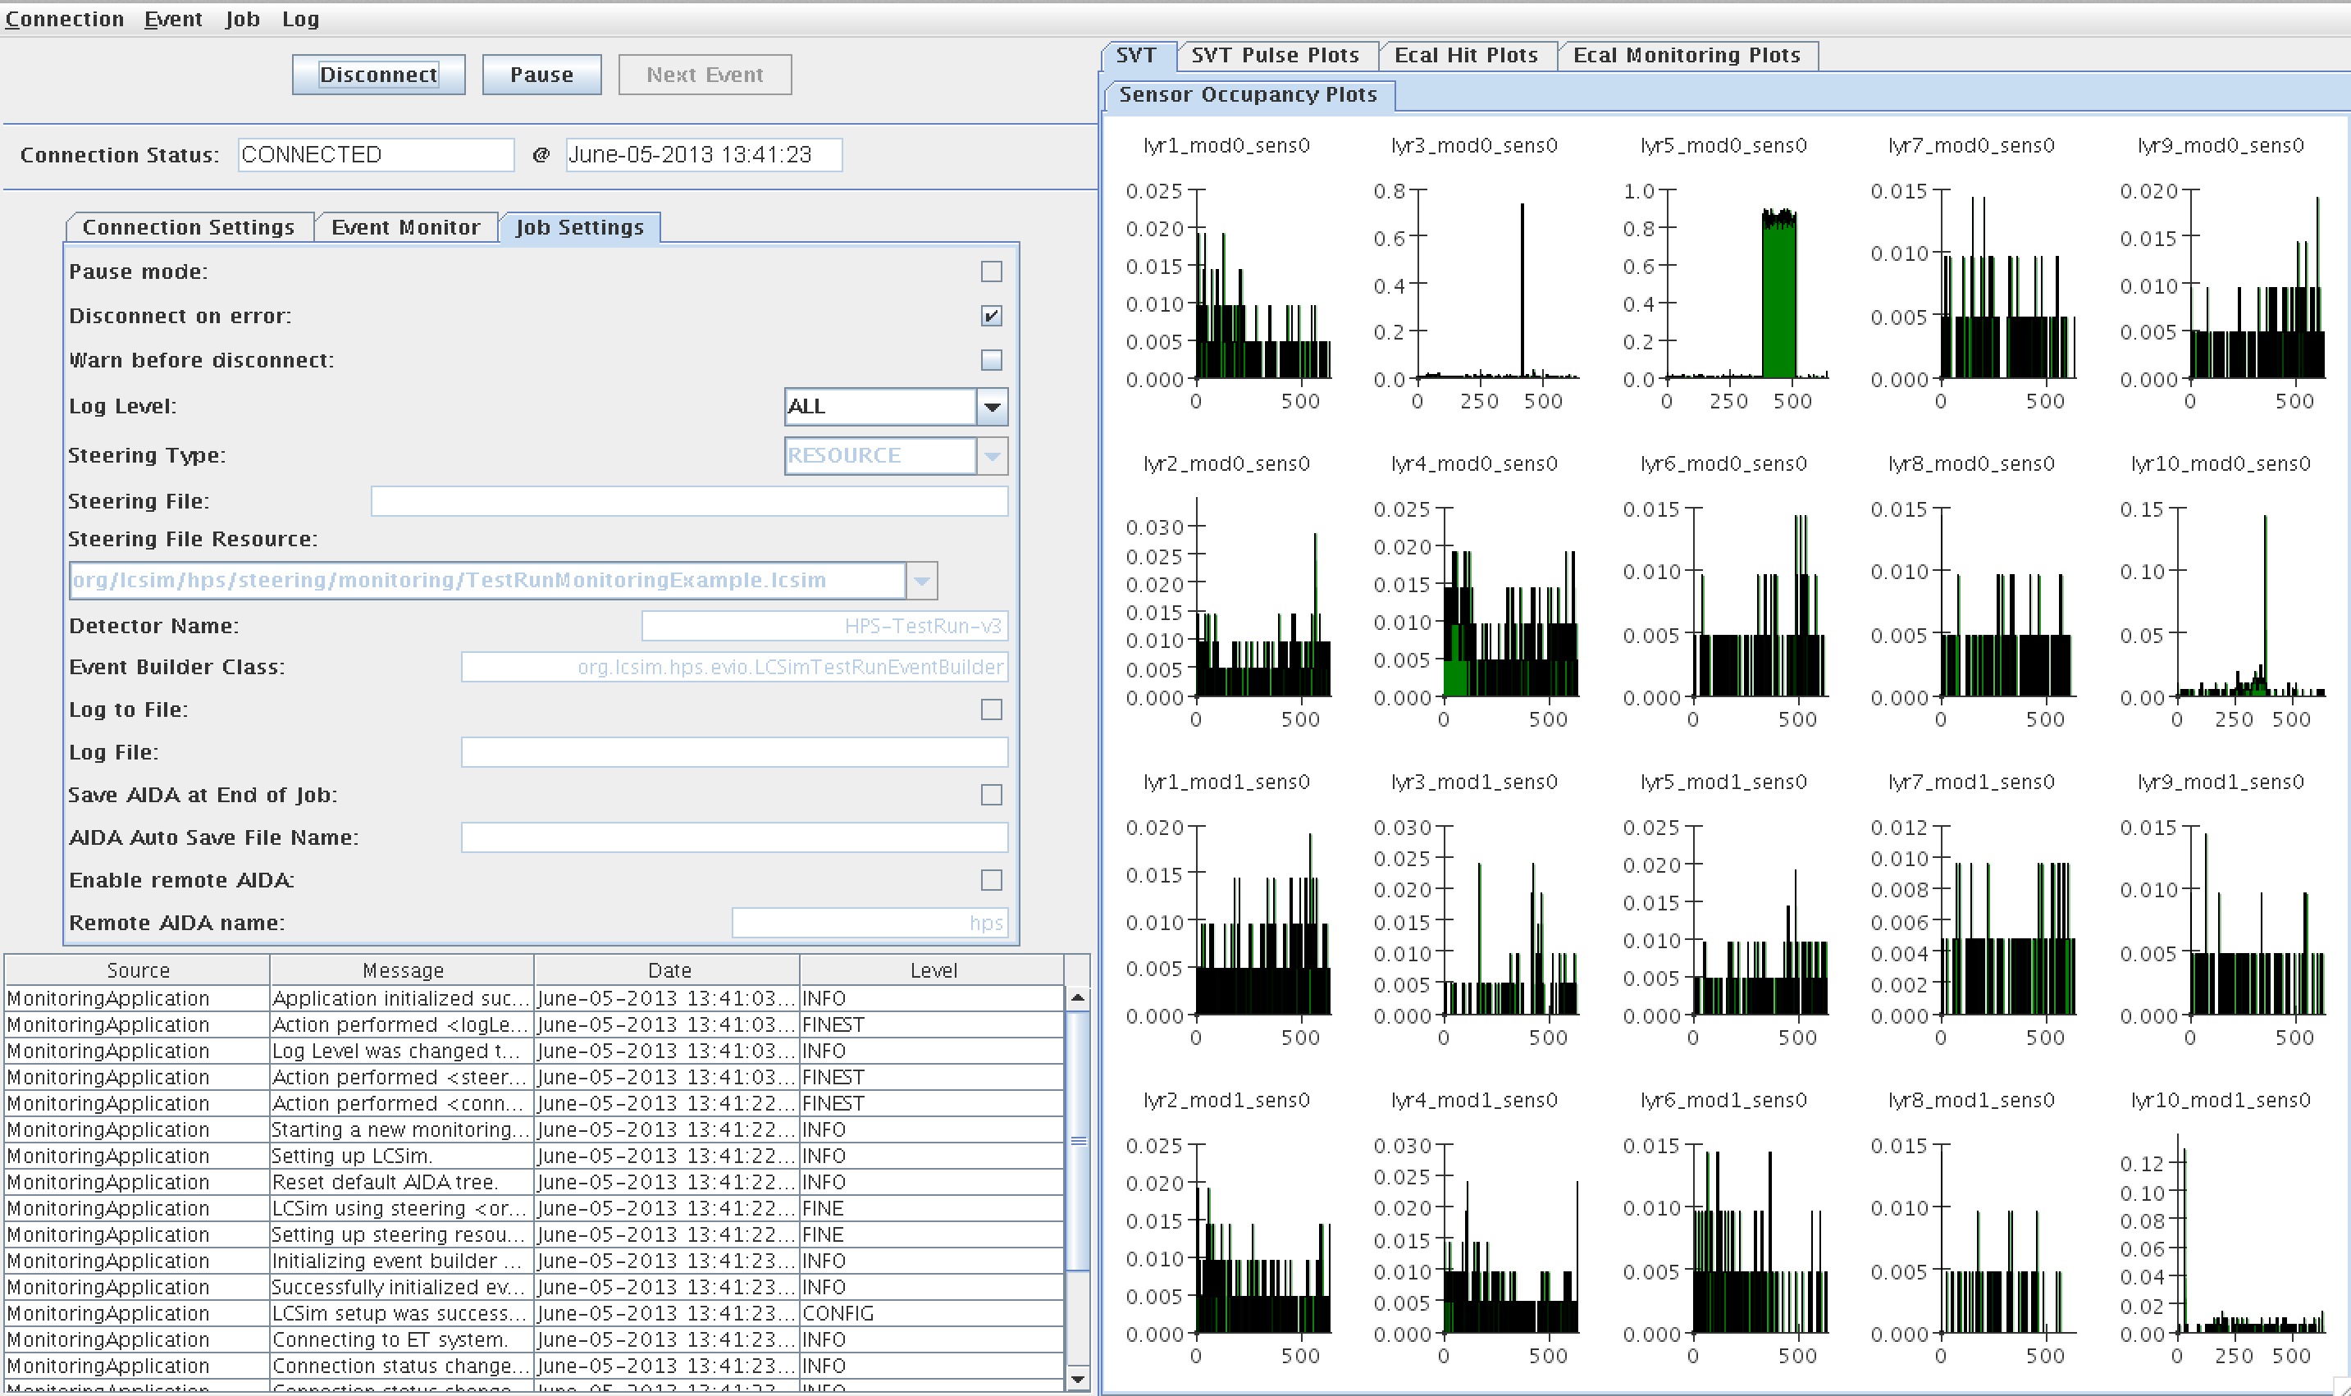
hps-java Monitoring Example

Slide 12
Monitoring Discussion
Q: What additional features are needed in the hps-java monitoring tool?
Q: Can we cut down the number of separate tools to a minimum set?
Understood subdetector groups will have own monitoring tools, but a large number could be hard to manage.
Q: Are additional monitoring tools needed?
For instance, app showing graphical status and/or data flow of all systems.
Q: What additional tools not covered by the hps-java Monitoring Application are needed?
esp. want to hear from DAQ groups

Slide 13
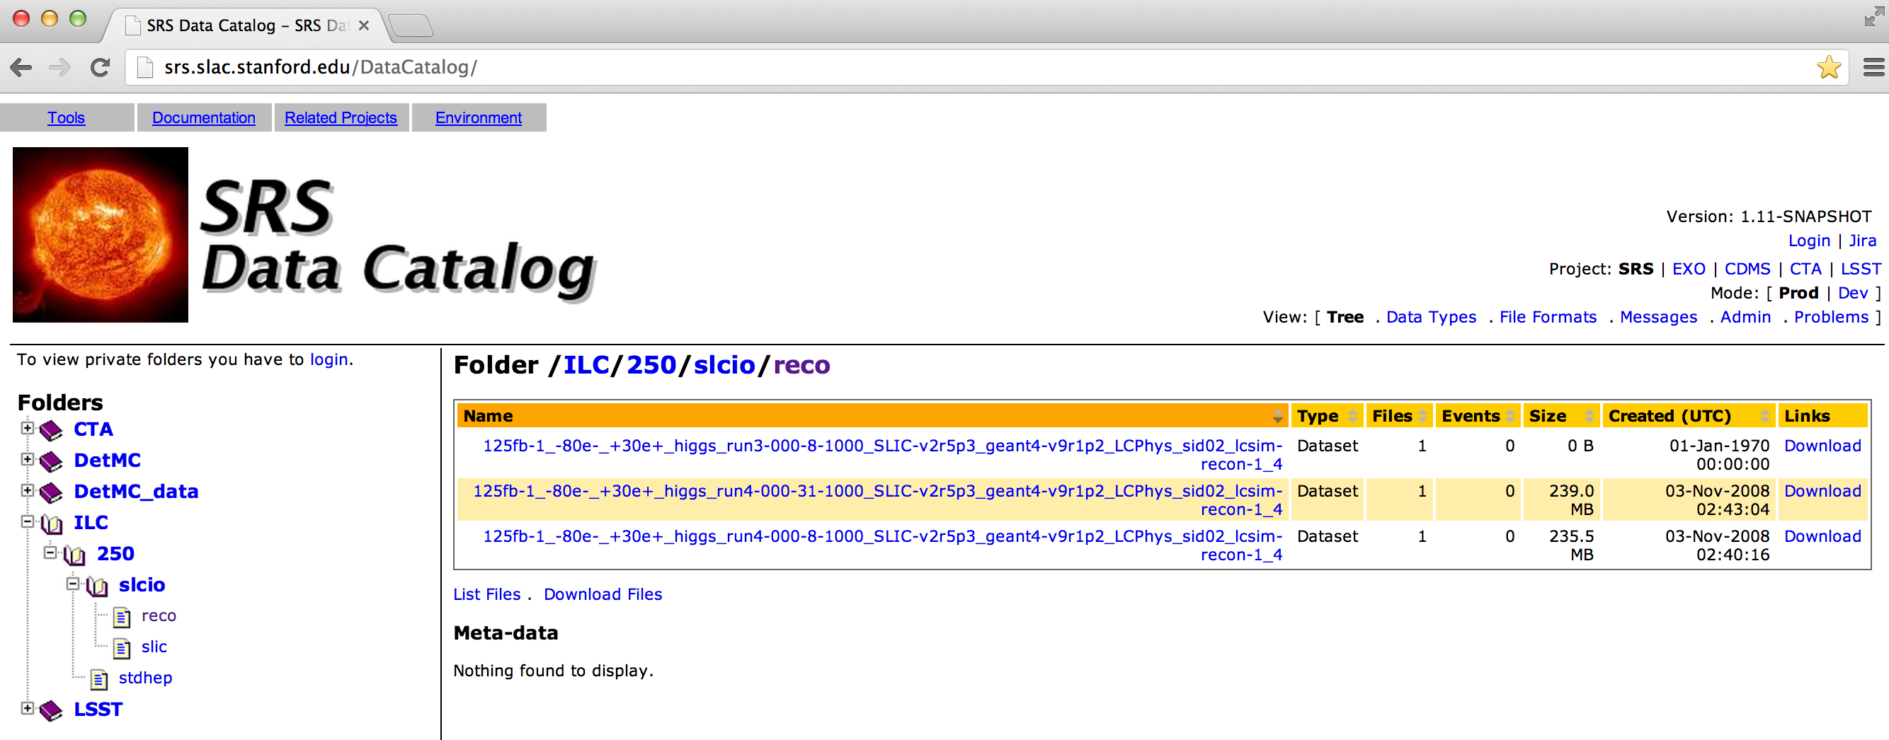
Data Catalog
Currently have no real online data catalog.
Useful for tagging data with metadata as well as allowing easy access to experimental collaborations.
SRS @ SLAC has a “generic” data catalog we could use.

